Slide 1
Map Index(i,j) into Timeperiod(i,t) by previous matrices:

Slide 2
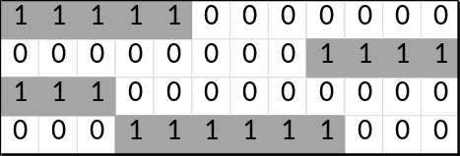

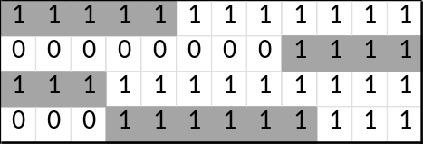

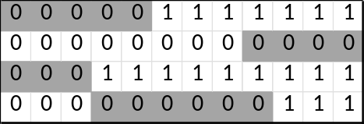


Slide 3
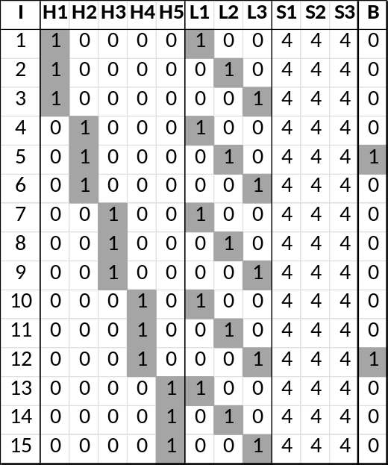

New hired initialization:
I: Consultant
H: Hierarchy
L: Location
S: Skillset
B: Binary indicator
For the original 400 consultants, their B indicators are all 1
So we set hire_initialization(i) above as real type of 400*1 with 100*0

